Slide 1
Approximation

Slide 2
Approximation
What for?
— Dealing with HARD problems
Getting around NP-completeness
☞ If N is small, even O(2^{N}) is acceptable
☞ Solve some important special cases in polynomial time
✓
☞ Find near-optimal solutions in polynomial time
— approximation algorithm
Notes:
注意：greedy等heuristics不管效果，approximation有近似解的质量方面的讨论。

Slide 3
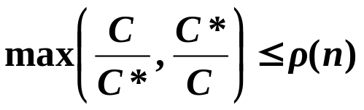
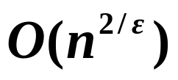
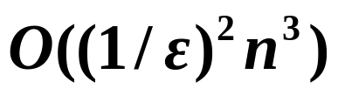
Approximation
Approximation Ratio
【Definition】 An algorithm has an approximation ratio of ρ (n) if, for any input of size n, the cost C of the solution produced by the algorithm is within a factor of ρ (n) of the cost C* of an optimal solution:
If an algorithm achieves an approximation ratio of ρ (n), we call it a ρ (n)-approximation algorithm.
【Definition】 An approximation scheme for an optimization problem is an approximation algorithm that takes as input not only an instance of the problem, but also a value ε > 0 such that for any fixed ε, the scheme is a (1+ ε)-approximation algorithm.
We say that an approximation scheme is a polynomial-time approximation scheme (PTAS) if for any fixed ε > 0, the scheme runs in time polynomial in the size n of its input instance.
fully polynomial-time
approximation scheme
(FPTAS)
Notes:
注：fully的意思是关于(1/epsilon)和n都是多项式级的

Slide 4
Approximation
Approximate Bin Packing
Given N items of sizes S₁ , S₂ , …, S_{N} , such that 0 < S_{i} ≤ 1 for all
1 ≤ i ≤ N . Pack these items in the fewest number of bins, each of which has unit capacity.
〖Example〗N = 7; S_{i} = 0.2, 0.5, 0.4, 0.7, 0.1, 0.3, 0.8
0.8
0.3
0.5
NP Hard
0.7
0.1
0.4
0.2
B₁
B₂
B₃
An Optimal Packing
Notes:
Decision problem: given K bins, can we pack N items? -- NPC

Slide 5
Approximation
❖ Next Fit
void NextFit ( )
{ read item1;
while ( read item2 ) {
if ( item2 can be packed in the same bin as item1 )
place item2 in the bin;
else
create a new bin for item2;
item1 = item2;
} /* end-while */
}
【Theorem】 Let M be the optimal number of bins required to pack a list I of items. Then next fit never uses more than 2M – 1 bins. There exist sequences such that next fit uses 2M – 1 bins.

Slide 6
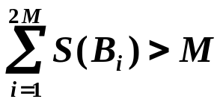
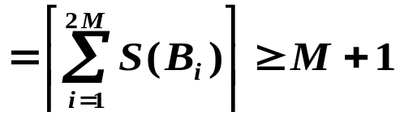
Approximation
A simple proof for Next Fit:
If Next Fit generates 2M (or 2M+1) bins, then the optimal solution must generate at least M+1 bins.
Let S ( B_{i} ) be the size of the ith bin. Then we must have:
S ( B₁ ) + S ( B₂ ) >1
S ( B₃ ) + S ( B₄ ) >1
…………
S ( B_{2M–1} ) + S ( B_{2M} ) >1
The optimal solution needs at least ⎡total size of all the items / 1⎤ bins
⎡total size of all the items / 1⎤

Slide 7
Approximation
❖ First Fit
void FirstFit ( )
{ while ( read item ) {
scan for the first bin that is large enough for item;
if ( found )
place item in that bin;
else
create a new bin for item;
} /* end-while */
}
Can be implemented in O( N log N )
【Theorem】Let M be the optimal number of bins required to pack a list I of items. Then first fit never uses more than 17M / 10 bins. There exist sequences such that first fit uses 17(M – 1) / 10 bins.
❖ Best Fit
Place a new item in the tightest spot among all bins.
T = O( N log N ) and bin no. ≤ 1.7M

Slide 8

Approximation
〖Example〗S_{i} = 0.2, 0.5, 0.4, 0.7, 0.1, 0.3, 0.8
Next Fit
First Fit
Best Fit
Discussion 14: Please show the results.
〖Example〗S_{i} = 1/7+ε, 1/7+ε, 1/7+ε, 1/7+ε, 1/7+ε, 1/7+ε,
1/3+ε, 1/3+ε, 1/3+ε, 1/3+ε, 1/3+ε, 1/3+ε,
1/2+ε, 1/2+ε, 1/2+ε, 1/2+ε, 1/2+ε, 1/2+ε
where ε = 0.001.
☞ The optimal solution requires ? bins.
However, all the three on-line algorithms require ? bins.
6
10

Slide 9


Approximation
☞ On-line Algorithms
Place an item before processing the next one, and can NOT change decision.
〖Example〗S_{i} = 0.4
, 0.4
, 0.6
, 0.6
You never know
when the input might end.
No on-line algorithm
can always give
an optimal solution.
0.4
0.6
0.6
0.4
【Theorem】There are inputs that force any on-line bin-packing algorithm to use at least 5/3 the optimal number of bins.
Notes:
还有worst fit（装最不满的）、almost worst fit、any fit —— 1.7倍

Slide 10

Approximation
☞ Off-line Algorithms
View the entire item list before producing an answer.
Trouble-maker: The large items
Solution: Sort the items into non-increasing sequence of sizes. Then apply first (or best) fit – first (or best) fit decreasing.
〖Example〗S_{i} = 0.2, 0.5, 0.4, 0.7, 0.1, 0.3, 0.8
0.8, 0.7, 0.5, 0.4, 0.3, 0.2, 0.1
0.2
0.3
0.1
【Theorem】Let M be the optimal number of bins required to pack a list I of items. Then first fit decreasing never uses more than 11M / 9 + 6/9 bins. There exist sequences such that first fit decreasing uses 11M / 9 + 6/9 bins.
0.4
0.8
0.7
0.5
Simple greedy heuristics can give good results.

Slide 11
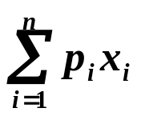
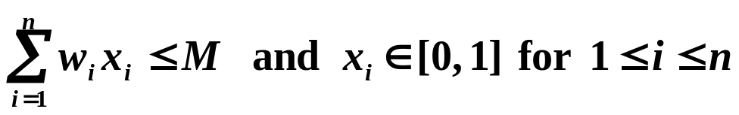
Approximation
The Knapsack Problem — fractional version
A knapsack with a capacity M is to be packed. Given N items. Each item i has a weight w_{i} and a profit p_{i} . If x_{i} is the percentage of the item i being packed, then the packed profit will be p_{i} x_{i} .
An optimal packing is a feasible one with maximum profit. That is,
we are supposed to find the values of x_{i} such that obtains its maximum under the constrains
Example :
n = 3, M = 20,
(p1, p2, p3) = (25, 24, 15)
(w1, w2, w3)= (18, 15, 10)
Solution is...?
Q: What must we do in each stage?
A: Pack one item into the knapsack.
Q: On which criterion shall we be greedy?
① maximum profit
② minimum weight
③ maximum profit density p_{i} / w_{i}
( 0, 1, 1/2 )
P = 31.5

Slide 12
Approximation
x_{i} is either 1 or 0
The Knapsack Problem — 0-1 version
NP-hard
Example :
n = 5, M = 11,
(p₁, p₂, p₃, p₄, p₅) = (1, 6, 18, 22, 28)
(w₁, w₂, w₃, w₄, w₅) = (1, 2, 5, 6, 7)
Solution is...?
The greedy solution is
( 0, 0, 1, 1, 0 )
P = 40
( 1, 1, 0, 0, 1 )
P = 35
What if we are greedy on taking the maximum profit or profit density?
The approximation ratio is 2.
Proof:
p_{max} ≤ P_{opt} ≤ P_{frac}
p_{max} ≤ P_{greedy}
P_{opt} / P_{greedy} ≤ 1 + p_{max} / P_{greedy} ≤ 2
P_{opt} ≤ P_{greedy} + p_{max}

Slide 13



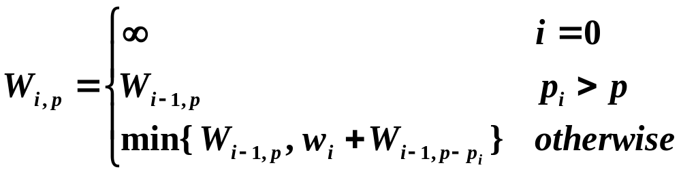
Approximation
☞ A Dynamic Programming Solution
W_{i, p} = the minimum weight of a collection from {1, …, i } with total profit being exactly p
① take i :
② skip i :
③ impossible to get p :
i = 1, …, n; p = 1, …, ?
O( n²p_{max} )
n p_{max}
Notes:
注意：input size包括Pmax的二进制编码长度d，所以Pmax=O(2^d)是指数级的复杂度。

Slide 14
Approximation
☞ What if p_{max} is LARGE?
Item
Profit
Weight
Item
Profit
Weight
1
134,221
1
1
2
1
2
656,342
2
2
7
2
3
1,810,013
5
3
19
5
4
22,217,800
6
4
223
6
5
28,343,199
7
5
284
7
M = 11
M = 11
 Round all profit values up to lie in smaller range!
(1+ε) P_{alg} ≤ P for any feasible solution P
precision parameter

Slide 15
Approximation
The K-center Problem
K = 4
r(C)
center
site
Input: Set of n sites s₁, …, s_{n}
Center selection problem: Select K centers C so that the maximum distance from a site to the nearest center is minimized.

Slide 16

Approximation
☞ What is a distance?
dist(x, x) = 0 (identity)
dist(x, y) = dist(y, x) (symmetry)
dist(x, y) ≤ dist(x, z) + dist(z, y) (triangle inequality)
dist(s_{i} , C) = min_{c∈C} dist(s_{i}, c)
= distance from s_{i} to the closest center
r(C) = max_{i} dist(s_{i}, C) = smallest covering radius
Find a set of centers C that minimizes r(C), subject to |C| = K.
∞
Number of candidate centers =

Slide 17
Approximation
☞ A Greedy Solution
Put the first center at the best possible location for a single center, and then keep adding centers so as to reduce the covering radius each time by as much as possible.
K = 2
☹ arbitrarily bad!
Notes:
注意：当N=2并且K=2时，其实最优解是把两个sites选为centers

Slide 18
Approximation
☞ A Greedy Solution — try again …
What if we know that r(C*) ≤ r where C* is the optimal solution set?
c*
s
r(C*)
Discussion 15:
Take s to be the center, how can we select r so that s can cover all the sites that are covered by c*?

Slide 19
Approximation
Centers Greedy-2r ( Sites S[ ], int n, int K, double r )
{ Sites S’[ ] = S[ ]; /* S’ is the set of the remaining sites */
Centers C[ ] = ∅;
while ( S’[ ] != ∅ ) {
Select any s from S’ and add it to C;
Delete all s’ from S’ that are at dist(s’, s) ≤ 2r;
} /* end-while */
if ( |C| ≤ K ) return C;
else ERROR(No set of K centers with covering radius at most r);
}
【Theorem】 Suppose the algorithm selects more than K centers. Then for any set C* of size at most K, the covering radius is r(C*) > r.

Slide 20
Approximation
Do we really know r(C*) ?
Binary search for r
0 < r ≤ r_{max}
Guess: r = ( 0 + r_{max} ) / 2
Yes: K centers found with 2r
or
No: r is too small
r₀ < r ≤ r₁
r = ( r₀ + r₁ ) / 2
Solution radius = 2r₁ —— 2-approximation
Notes:
If r is an integer, then T=O(log r) -- polynomial

Slide 21
Approximation
A smarter solution — be far away
Centers Greedy-Kcenter ( Sites S[ ], int n, int K )
{ Centers C[ ] = ∅;
Select any s from S and add it to C;
while ( |C| < K ) {
Select s from S with maximum dist(s, C);
Add s it to C;
} /* end-while */
return C;
}
【Theorem】 The algorithm returns a set C of K centers such that r(C) ≤ 2r(C*) where C* is an optimal set of K centers.
—— 2-approximation
Notes:
注：简要叙述证明，用反证法。若结果r>r*，则每步添加的s距离都>2r*。根据前一个算法的结论，S’在K步以内必然非空，推出K-center无解满足r*。

Slide 22
Approximation
☞ Is there a hope of a 3/2-approximation? Or 4/3?
【Theorem】 Unless P = NP, there is no ρ -approximation for center-selection problem for any ρ < 2.
Sketch of the proof: By contradiction.
If we can obtain a (2-ε)-approximation in polynomial time, then we can solve DOMINATING-SET (which is NP-complete) in polynomial time.
Dominating set problem has a solution of size K iff there exists K centers C* with r(C*) = 1.
Then a (2-ε)-approximation must give the optimal solution since all the distances involved are integers.

Slide 23
Approximation
Three aspects to be considered:
A: Optimality
B: Efficiency
C: All instances
-- quality of a solution
-- cost of computations
Researchers are working on
A+C: Exact algorithms for all instances
A+B: Exact and fast algorithms for special cases
B+C: Approximation algorithms
Even if P=NP, still we cannot guarantee A+B+C .

Slide 24

Research Project 5
Texture Packing (26)
Texture Packing is to pack multiple rectangle shaped textures into one large texture. The resulting texture must have a given width and a minimum height.
You are to design and analyze an approximation algorithm that runs in polynomial time.
Detailed requirements can be downloaded from
https://pintia.cn/

Slide 25
Reference:
Data Structure and Algorithm Analysis in C (2nd Edition)：Ch.10，p.359-366；M.A.Weiss著、陈越改编，人民邮件出版社，2005
Introduction to Algorithms, 3rd Edition: Ch.35, p.1106 -1140； Thomas H. Cormen, Charles E. Leiserson, Ronald L. Rivest and Clifford Stein. The MIT Press. 2009

